Slide 1

DATA STRUCTURES AND ALGORITHMS - I
OBJECT ORIENTED PROGRAMMING WITH JAVA
SEATING ARRANGEMENT SYSTEM
Team Members:
Amogh Dey CB.SC.U4AIE24303
Athul Adithyan N CB.SC.U4AIE24306
KV SREE RAMA KUMAR CB.SC.U4AIE24326
PATURI MANOHAR CB.SC.U4AIE24339

Slide 2


PROBLEM STATEMENT & OBJECTIVES
Problem:
Educational institutions face challenges in efficiently managing venues, events and seating arrangements, leading to confusion, delays, and administrative overhead.
Objectives:
Develop a secure, role-based system that automates venue, event management and seat reservation/allocation in Java (IDE : IntelliJ IDEA Ultimate).
Implement a hierarchical user management system (Admin → Faculty → Student)
Faculty can reserve venues for events and control access for said event.
Students can reserve/cancel seats for events.
Implement appropriate DSA and OOP concepts for optimal performance and modular, scalable design.

Slide 3
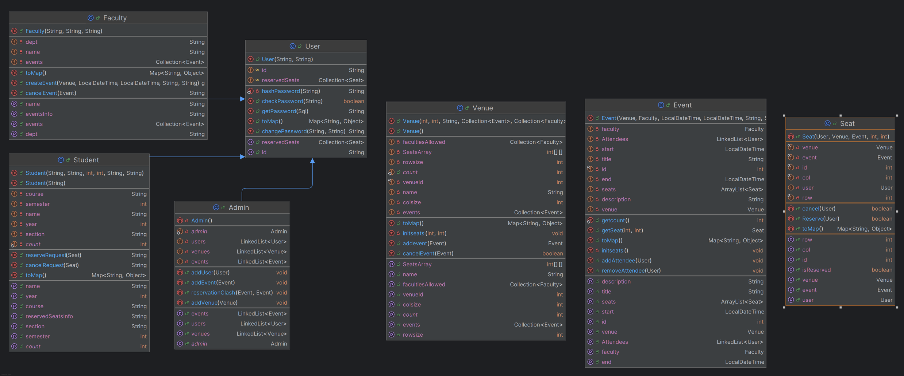

Slide 4

APPROACH
Object-Oriented Modeling Entities such as User, Student, Faculty, Admin, Venue, Event, and Seat were modeled as classes with relevant relationships (inheritance, aggregation, composition). Common user behaviors were abstracted in the User class and extended in Student and Faculty.
Data Structures and Design Choices Used LinkedList for dynamic collections of users and events. 2D array Seat[][] in Venue class simulates real-world seat layouts.
Access Control & Functional Segregation Admin: Can create users, venues, and events. Faculty: Create and cancel events. Students: Reserve and cancel seat requests. Each class handles only its responsibilities, promoting encapsulation and low coupling.

Slide 5

DETAILED DESIGN & IMPLEMENTATION:
User Class (Base Class) The Student class represents a student user who can reserve and cancel seats for events. It inherits from the User class and adds academic-specific fields.
Relationships Inheritance: User is a base class for subclasses like Faculty, Student, and possibly Admin. Association: A User can reserve multiple seats across different events. Maintains a list of Seat objects that represent the user’s current reservations.
Highlights Reservation-aware: Holds info about all seats the user has booked, allowing for restrictions (like one seat per event). Extendable: Easily overridden and extended by subclasses (Faculty, Student, etc.).

Slide 6
DETAILED DESIGN & IMPLEMENTATION:
Admin Class: Represents the system administrator. It's a singleton class extending User, with full control over users, venues, and events.
Relationships Inheritance: Inherits from User. Singleton Design Pattern: Only one Admin instance exists throughout the application using the getAdmin() method. Associations: Manages: All User objects (students + faculty). All Venue objects. All Event objects. Keeps track of reservation clashes between events by Faculty.
Highlights Central controller of all system data. Uses the singleton pattern to enforce one admin. Keeps track of booking conflicts

Slide 7
DETAILED DESIGN & IMPLEMENTATION:
Faculty Class The Faculty class represents faculty users who can create, manage, and cancel events. It inherits from User and manages a list of events they organize.
Relationships Inheritance :Faculty extends User → inherits id, password, and reservedSeats. Composition: Faculty owns the events it creates → strong composition (lifecycle is tied to Faculty). Association (Bidirectional): Uses the Venue class for creating events → aggregation. Interacts with Event objects directly. Event Management createEvent(Venue, start, end, title, description): String Creates and adds an event to both the venue and the faculty’s own list. cancelEvent(Event): String Removes an event from both the venue and faculty’s list if it was created by this faculty.
Faculty objects are responsible for event lifecycle management. They serve as event creators and coordinators, with control over where and when the event happens.

Slide 8
DETAILED DESIGN & IMPLEMENTATION:
Student Class: The Student class represents a student user who can reserve and cancel seats for events. It inherits from the User class and adds academic-specific fields.
Relationships: Inheritance: Student extends User → inherits id, password, and reservedSeats. Association (Uses): Interacts with the Seat class → Aggregation (uses Seat objects but doesn’t own their lifecycle). Composition (Inherited): reservedSeats (from User) holds Seat objects → the student has control over their list of reserved seats.
Reservation Methods: reserveRequest(Seat seat): String Attempts to reserve a seat and adds it to the reserved list if successful. cancelRequest(Seat seat): String Cancels a reservation and removes the seat if it was reserved by the student.
This class is the core actor in the system for interacting with event seating. It encapsulates reservation logic, making it easy to trace and debug student-specific operations.

Slide 9
DETAILED DESIGN & IMPLEMENTATION:
Venue Class The Venue class represents a physical or virtual space where events can be hosted. It maintains a seating layout and tracks which faculty are authorized to create events here.
Relationships: Association (Aggregation): Has a list of Event → Events are aggregated; they can exist independently but are tied to a venue. Linked to multiple Faculty objects through facultiesAllowed → Loose association (access control, not ownership). Composition: Contains a SeatsArray initialized internally → composition (tightly bound to the Venue).
Event Management: addevent(Event): Event Adds an event only if no time clash occurs and the faculty is authorized. Returns the added event or the conflicting event. cancelEvent(Event): boolean Removes an event from the venue’s event list if it exists.
the Venue class is the core event-hosting location. It manages seat layout, event scheduling, and faculty permissions. It also checks for conflicts between new and existing events before adding them.

Slide 10
DETAILED DESIGN & IMPLEMENTATION:
Event Class Represents a scheduled event in a specific Venue, hosted by a Faculty, and contains its own set of Seats for attendees. It manages attendees, seat availability, and student access restrictions.
Relationships Aggregation: Associated with a single Venue (provided as input). Linked to one Faculty (event organizer). Composition: Composed of Seat objects → Event creates its own seats using the venue’s size, meaning seats have no independent existence outside the event. Association: Maintains a list of User attendees (LinkedList<User>). Holds a HashMap<String, String[]> named StudentAccess which represents section/semester restrictions.
Methods Seat Initialization (initseats): For each coordinate (i, j) in the venue's size, a Seat is created and stored → composition. Seat Management: getSeats(), getSeat(row, col) – Return all seats or a specific seat. Attendee Management: addAttendee(User), removeAttendee(User) – Maintain attendees list.
The Event is a core scheduling unit, managing who can access it (via StudentAccess), who attends it (Attendees), and how its seating is laid out dynamically based on the venue. Each event is unique and self-contained with respect to seat arrangement.

Slide 11
DETAILED DESIGN & IMPLEMENTATION:
Seat Class Represents a single seat in a specific Event at a Venue. It keeps track of reservation status, which User booked it, and where it is located in the layout (row & column).
Relationships: Composition (strong): Seats are composed by an Event – they don’t exist independently and are initialized during event creation. A seat is also tightly bound to a Venue, since it's part of the venue's seating arrangement. Association: Associated with a User if reserved (nullable). One seat is uniquely associated with a (row, col) coordinate in a specific venue.
Highlights One seat per event: Uniquely identified by (row, col) in the venue. User-event consistency: No double-booking per user in the same event. Bidirectional updates: When a seat is reserved or cancelled, both the seat and the event’s attendee list are updated.

Slide 12



OOP PRINCIPLES IN PRACTICE
OOP Principle
Description
Example
Encapsulation
prevents unauthorized access of data from other parts of the program
Private attributes and public methods for controlled access
Inheritance
Defining a new class based on an existing class, inheriting its properties and methods
Student,Faculty,Admin,class inheriting from a User class
Polymorphism
Method overloading and Overriding
Overriding the toMap() method
Overloading constructors
Singleton Pattern
creational design pattern that ensures a class has only one instance, providing a global point of access to that instance
Admin class
*OOP Principles Implementation

Slide 13

DSA CONCEPTS
Data Structures
Linked List
used as a collection for Objects
Array
used for seat Layout, and as a collection(ArrayList) for storing Seat Objects
HashMap
Used for storing mappings for student Access and for sending data to frontend of HTML and JS
Algorithms used
SHA-256 : Secure Hash Algorithm - 256. A cryptographic hash function that produces a 256-bit hash value (32 bytes) from any given input
SHA-256 is part of the SHA-2 family of algorithms and is widely used in various security applications, including digital signatures and data integrity verification
Time complexity (big - O): O(n)

Slide 14


PROJECT ACCOMPLISHMENTS & FUTURE ENHANCEMENTS
Conclusion
Core OOP Principles
Data Structures
Successfully implemented a role-based seating arrangement system.
Applied core OOP principles (encapsulation, inheritance, polymorphism, abstraction).
Utilized appropriate data structures (linked lists, maps, arrays,priority queue).

Slide 15
Thank you

